Slide 1



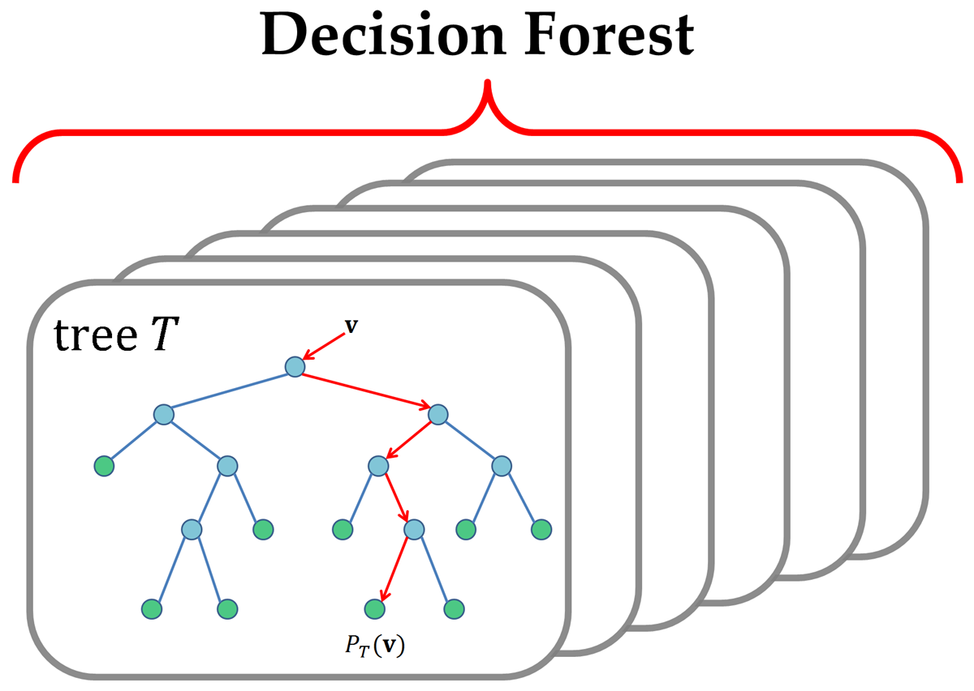




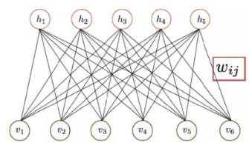
DP Review.com
flickr
Online Channel
Feature Classifier
RFM Score
Klachaks DB
Hybrid Recommendation System
- Content and CF
Offline Channel
USER_ITEM_RATING
ITEM_ITEM_SIMILARITY
Recommender
Systems

Slide 2
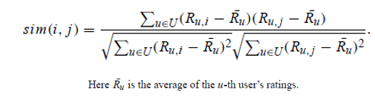

Slide 3
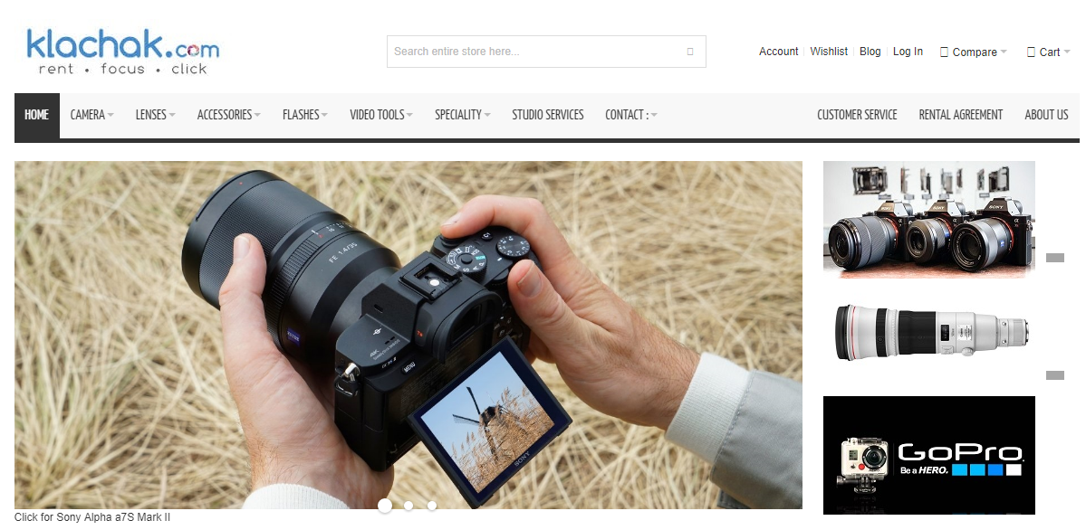
User : JD

Slide 4
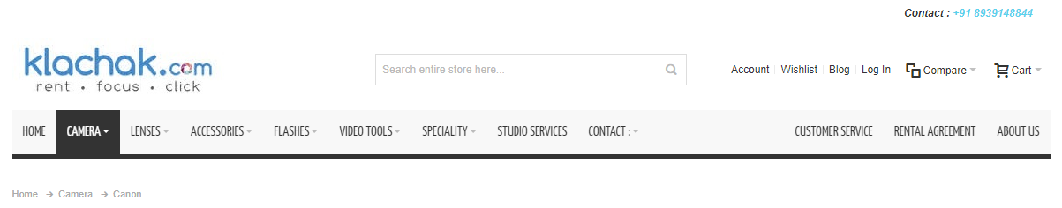

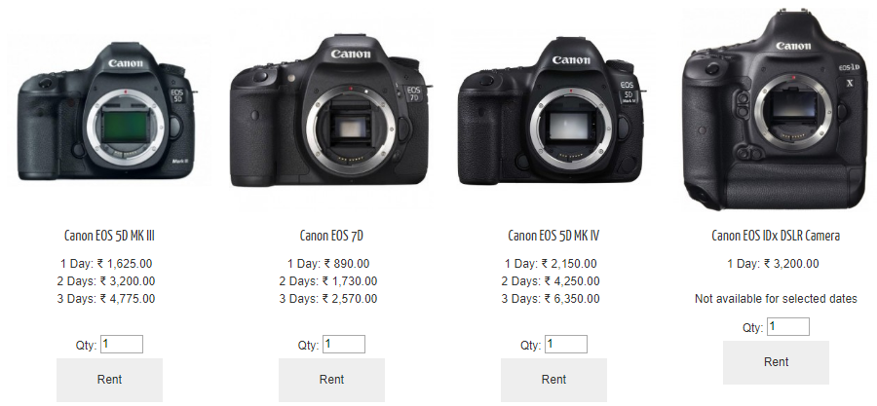









User : JD
On Selecting this…
You may also be Interested to…
Recommend these
32
NA
Sentiment Analysis
12

Slide 5
Transaction Frequency
Customer Segment
Ratings
Sales Data
Sales Data
Customer -> Product
Customer Segmentation - RFM
Weighted Probability
Profiling
Weighted Probability

